Slide 1

EAST POINT COLLEGE OF ENGINEERING & TECHNOLOGY
Department of Computer Science and Engineering (IoT&CSBT)
BIC685 - Project Presentation
Project Title: “Safe Alert: A Secure Crime Tip-Off and Reporting System”
By:
M Prem Venkat (1EP22IC029)
Nisha K (1EP22IC035)
Niveditha C (1EP22IC036)
Syeda Saniya Khazi (1EP22IC054)
Under the Guidance of
Dr. Nanda Ashwin
Prof & HOD, Dept. of CSE (IoT & CSBT)
Project Committee
Dr. Komala C R
Professor, Dept. of CSE (IoT&CSBT)
Dr. Nanda Ashwin
Prof & HOD, Dept. of CSE (IoT&CSBT)

Slide 2
Presentation Outline
Abstract
Objectives
Introduction
Problem Statement
Existing System
Proposed System
Literature Survey
Project Schedules/Gantt Chart
Required Specification
Methodology
Expected Results
Conclusion
References

Slide 3
ABSTRACT
Secure tip provides a safe and anonymous platform for individuals to report suspicious criminal activities without fear of retaliation, ensuring user confidentiality through Encryption and Blockchain technology.
The system uses AES encryption to securely protect communication between the user and server. Blockchain ensures data cannot be tampered with once it's recorded. IPFS safely stores multimedia files and maintains their integrity and confidentiality.
The system uses Django to create an easy-to-use interface. It helps with smooth data handling, balancing the system's workload, and organizing reports.
Law enforcement can use an interactive dashboard to view anonymized user lists, multimedia evidence, and train machine learning models. This helps them investigate cases quickly and prevent crimes before they happen.
Ganache and Metamask improves the connection with the Blockchain. They make transactions secure, efficient, and easy to manage.

Slide 4
OBJECTIVES
The objective of the project is to enhance security, faster, and more trustworthy to report suspicious activities to crime authorities.
Implementing AES Encryption to keep the identity of the person hidden and ensure secure transmission of information.
Utilizing blockchain to store the tips on a blockchain, so no one can change them, ensuring that the information stays accurate and trustworthy.
Integrating Tensorflow CNN to automatically check if the information provided is true.
Employing IPFS for a system to store things like images or videos linked to the tips, making sure they are easy to access.

Slide 5
INTRODUCTION
Crime prevention heavily depend on public cooperation, but many individual hesitate to report suspicious activities due to fear and concerns over security.
Traditional ways of reporting crimes don’t keep people’s identities secret, so they are less likely to share important information.
With the rise of both cyber and physical crimes, authorities need a quick and effective way to get and handle crime reports.
A well-organized and safe system can help authorities respond faster and more efficiently to reports.
The goal of this project is to develop a secure and anonymous crime tip-off platform that enables individuals to report suspicious activities while ensuring confidentiality and data security for law enforcement.

Slide 6
PROBLEM STATEMENT
Many individuals hesitate to report crimes due to concerns over personal safety, discouraging valuable tip-offs that could aid law enforcement.
Existing crime reporting mechanisms often lack sufficient security measures, exposing users to privacy risks and discouraging participation.
Law enforcement agencies receive numerous tips, but without a proper system for prioritizing and verifying reports, valuable leads may be overlooked.
Crime reporting may involve images, videos, or documents, but conventional systems often struggle with secure storage and retrieval of such evidence.
In the absence of a tamper-proof system, crime reports may be altered, deleted, or misused, leading to loss of public trust and inefficiency in law enforcement efforts.

Slide 7
EXISTING SYSTEM
Most surveillance systems today depend on people watching video feeds, which takes a lot of time and can lead to mistakes—especially because suspicious events are rare and there's a huge amount of footage to review. Also, many reporting tools don’t let people stay anonymous, so they’re afraid to speak up in case they get in trouble. The way the data is stored isn't very secure either—it's kept in one place, which makes it easier for someone to change, steal, or delete it. Reports are often handled manually, which means police or authorities have to spend a lot of time checking and sorting them. And finally, these systems often don’t support images or videos properly, or they don’t store them safely, which makes solving crimes harder.

Slide 8
PROPOSED SYSTEM
The proposed system offers a secure and anonymous platform for witnesses to report suspicious activities to crime authorities, ensuring confidentiality, integrity, and accuracy of information. It employs AES encryption to protect user-server communication, preventing unauthorized access or data interception. Blockchain technology, specifically Ethereum, is integrated to store crime reports as immutable records using smart contracts, ensuring data integrity and preventing tampering. Blockchain is a decentralized ledger that securely records transactions, making it ideal for maintaining trust in crime reporting.
The system also utilizes a TensorFlow Convolutional Neural Network (CNN) model to analyze submitted tips and predict their authenticity, helping authorities prioritize credible reports efficiently. CNN is a deep learning algorithm designed to process and recognize patterns in images and text, improving the accuracy of tip classification. Additionally, IPFS ensures secure multimedia storage for evidence submission.

Slide 9
LITERATURE SURVEY
TITLE | AUTHORS | METHODOLOGY | DRAWBACKS | RESULTS | LINK
K-Anonymity for Privacy Preserving Crime Data Publishing in Resource Constrained Environments | Burke Mark-John and Kayem Anne V.D.M | Developed a mobile CBCR framework and a hybrid k-anonymity algorithm utilizing hierarchy-based generalization to ensure privacy preservation, minimize information loss, and optimize classification accuracy for crime data. | Limited classification accuracy (38%) may affect actionable insights. Algorithm effectiveness depends on dataset quality and size, and manual processing challenges within law enforcement agencies remain partially addressed. | Ensures privacy-preserving crime data publishing with reduced information loss and improved processing time. Further refinement is needed to enhance classification accuracy and adapt to diverse law enforcement needs. | https://ieeexplore.ieee.org/document/6844743

Slide 10
LITERATURE SURVEY
TITLE | AUTHORS | METHODOLOGY | DRAWBACKS | RESULTS | LINK
Toward an mPolicing solution for Namibia: Leveraging emerging mobile platforms and crime mapping | Jensen, K. L., Iipito, H. N., Onwordi, M. U. and Mukumbira, S. | Designed a mobile application for report creation using device sensors to capture contextual data, integrated a central repository for data sharing, and developed GIS-enabled crime mapping tools. | Limited evaluation in early phases may not reflect full scalability. Dependency on mobile devices and connectivity could hinder adoption in resource-constrained areas or during network outages. | Enhances efficiency in report creation and stakeholder collaboration through mobile technology and GIS integration. Further testing and optimization are required to ensure reliability and widespread usability. | https://www.researchgate.net/publication/262166703_Toward_an_mPolicing_solution_for_Namibia_Leveraging_emerging_mobile_platforms_and_crime_mapping

Slide 11
LITERATURE SURVEY
TITLE | AUTHORS | METHODOLOGY | DRAWBACKS | RESULTS | LINK
When crime reporting goes high-tech: An experimental test of computerized citizen response to crime | Lasley, J.R. and Palombo, B.J. | Used a randomized experimental design with 140 subjects to compare crime reporting rates between telephonic and computer interactive modes, analyzing behavior across low and moderate crime seriousness levels. | Controlled laboratory setting may not replicate real-world complexities. Limited sample size and focus on two modes could overlook other influential factors affecting citizen crime reporting decisions. | Computer interactive reporting mode significantly increases reporting rates, particularly for less severe crimes, indicating potential for technology to enhance crime reporting but requiring validation in real-world settings. | https://www.sciencedirect.com/science/article/abs/pii/0047235295000437

Slide 12
LITERATURE SURVEY
TITLE | AUTHORS | METHODOLOGY | DRAWBACKS | RESULTS | LINK
Feature Based Training for Crime Detection using Deep Learning Techniques | P. Mahalakshmi, S. Thenmalar | Extract spatiotemporal features from sequential video frames using a pretrained CNN model, followed by anomaly classification via Bi-LSTM, enabling detection of unusual events in surveillance footage. | May struggle with complex or highly dynamic scenes, depends on quality of pretrained models, and can require significant computational resources for feature extraction and Bi-LSTM processing. | The framework effectively detects anomalies in surveillance videos, enhancing public safety, but further optimization is needed for handling diverse environments and reducing computational complexity in real-time scenarios. | https://ieeexplore.ieee.org/document/10369315

Slide 13
LITERATURE SURVEY
TITLE | AUTHORS | METHODOLOGY | DRAWBACKS | RESULTS | LINK
Deep Convolutional Generative Adversarial Networks for Crime Scene Object Detection | Uma N | Employ Deep Convolutional GANs with perceptual loss functions, feature pyramid networks, and attention mechanisms to generate high-resolution images, enhancing object detection in crime scenes using benchmark datasets. | May face limitations with diverse crime scene complexities, requires extensive computational power, and could encounter challenges in achieving real-time detection due to GAN model processing demands. | The approach improves crime object detection with 98.56% accuracy, demonstrating effectiveness, yet further optimization is needed for handling diverse scenarios and reducing computational requirements for practical deployment. | https://ieeexplore.ieee.org/document/10250517

Slide 14
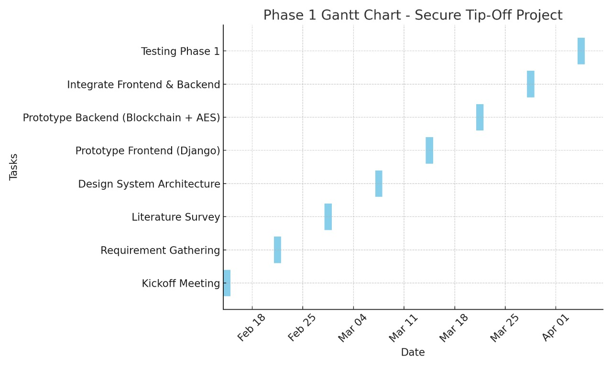
PROJECT SCHEDULES/GANTT CHART

Slide 15
REQUIREMENTS SPECIFICATION
Requirement Specification
Python IDLE ( 3.7.0)
Node Js
Visual Studio Community Version
Ganache
MetaMask - Chrome Extension
Back-end Languages
Python
Java Script
Solidity
Framework
Django
Front-end Languages
HTML
CSS
JS
Bootstrap4
Hardware Requirements
Processor : i5 and above
RAM : 8GB and above
ROM : 20GB and above

Slide 16
METHODOLOGY
New User Sign up: Using this module user can sign up with the application.
User Login: Using this module user can login to application and all user details will be managed with server in AES encrypted format.
Submit your Tip: After login using this module user can submit tip about any suspicious activities.
View your Past Tips: Using this module user can view all submitted tip reports.
Authority Login: Authority can login to system using username and password as ‘admin’. After login authority can perform following options.
Train ML: Using this module authority can train ML to predict weather submitted tip is false or true.
View Submitted Tips Report: Using this module authority can view all submitted tips and machine learning predicted top status as true or false.
View User Lists: Using this module authority can view all registered user details but all username will be anonymised for security reason.

Slide 17
EXPECTED RESULTS
People can report crimes without revealing their identity, which encourages more people to come forward without fear.
Tips reach the authorities quickly, helping them respond to suspicious activities in real time or before crimes happen.
Reports, images, and videos are stored securely, so they can’t be changed, deleted, or accessed by the wrong people.
The system helps sort and prioritize reports automatically, saving time for the authorities and allowing them to focus on urgent cases.
Reporters can upload photos and videos as proof, making investigations more effective and accurate.
All information is safely recorded so it can be trusted in future investigations or legal cases.

Slide 18
CONCLUSION
The project provides a robust platform that allows witnesses to report suspicious activities anonymously, ensuring their safety while enhancing collaboration with law enforcement.
By leveraging Ethereum blockchain, the system ensures that crime reports remain immutable and tamper-proof, fostering trust between users and authorities.
The TensorFlow CNN model improves the credibility of reported tips by analyzing and predicting their authenticity, helping authorities prioritize genuine cases efficiently.
With IPFS for decentralized multimedia storage, the system securely handles evidence, preserving crucial information for investigations.
By integrating encryption, blockchain, machine learning, Ganache, and MetaMask, the system enhances the security, efficiency, and accuracy of crime reporting, contributing to faster responses from authorities and ultimately safer communities.

Slide 19
REFERENCES
Burke Mark-John and Kayem Anne V.D.M., (2014) “K-Anonymity for Privacy Preserving Crime Data Publishing in Resource Constrained Environments”, May 13-16, 2014.
Jensen, K. L., Iipito, H. N., Onwordi, M. U. and Mukumbira, S. “Toward an mPolicing solution for Namibia: leveraging emerging mobile platforms and crime mapping”, 2012.
Lasley, J.R. and Palombo, B.J. “When crime reporting goes high-tech: An experimental test of computerized citizen response to crime”, 1996.
P. Mahalakshmi, S. Thenmalar, "Feature Based Training for Crime Detection using Deep Learning Techniques“, 2023.
Uma N, "Deep Convolutional Generative Adversarial Networks for Crime Scene Object Detection", 2023.

